Slide 1

Market Research Study
Nykaa's Strategic Ascendancy in Indian E-Commerce
A Comprehensive Analysis: How a Specialized Beauty Platform Outmaneuvered Horizontal Giants
Prepared for Strategic Review

Slide 2
Research Overview
20 Pages
Research Framework
6 Research Pillars
01
Executive Summary
02
Consumer Psychology
The Indian BPC market transformation and Nykaa's market capture strategy
Understanding the trust deficit that plagued horizontal e-commerce platforms
03
Business Model Analysis
04
Content-to-Commerce
Inventory model advantages, unit economics, and regulatory arbitrage
Nykaa's education-first marketing engine and omnichannel strategy
05
Financial Performance
06
Strategic Conclusions
Retention metrics, CAC analysis, and profitability indicators
Market implications and lessons for vertical integration in emerging markets
Data Sources: Think School Business Case Study, Nykaa IPO Filings, Indian BPC Market Research 2016-2021

Slide 3

Chapter One
Executive
Summary
The Indian Beauty & Personal Care Market Transformation

Slide 4
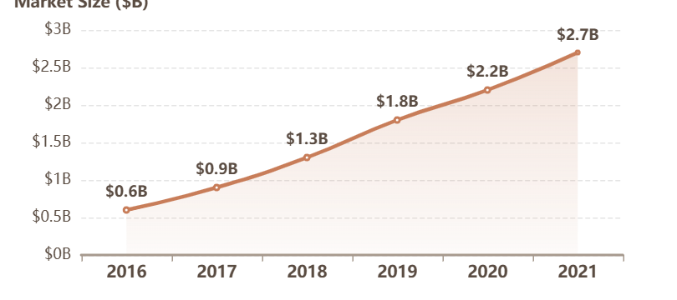
Executive Summary
The Indian BPC Market: From $600M to $2.7 Billion
$2.7B
8%
4.5x
2021 Market Size
Market Penetration
5-Year Growth
Online BPC market reached $2.7 billion, up from $600M in 2016
Only 8% penetration indicates massive runway for secular growth
Market expanded 4.5x between 2016-2021, demonstrating accelerating adoption
Market Growth Trajectory (2016-2021)
Nykaa's Strategic Positioning
This was not a saturated market. It was an emerging battlefield where trust, not price, determined the winners.
Nykaa entered using a vertical integration model that prioritized authenticity and education over discounting, capturing the majority of this high-stakes, high-margin sector.
Key Finding: Horizontal marketplaces optimized for variety could not guarantee the quality control and guidance that beauty consumers demanded, creating a vacuum Nykaa filled.

Slide 5

Chapter Two
Consumer
Psychology
Understanding the Trust Deficit in Indian E-Commerce

Slide 6
Consumer Psychology
The Counterfeit Crisis: Why Horizontal Platforms Failed
Open Marketplace Vulnerability
The Polluted Supply Chain
Amazon and Flipkart operated on open third-party seller models. This structure allowed counterfeit and duplicate products to flood the system. Third-party sellers pushed heavily discounted fake goods to the top of search results through algorithmic price optimization.
Authentic Products
35%
Counterfeit/Duplicate
45%
Near-Expired
20%
Dermatological Risk Beyond Financial Loss
The risk extended beyond financial loss. Counterfeit cosmetics caused skin allergies, chemical burns, and long-term dermatological damage. The Indian consumer psyche was acutely sensitive to severe skin reactions from unregulated, chemically dubious duplicates.
Estimated composition of beauty products on horizontal marketplaces
Critical Gap: The Indian buyer needed guidance on skin type compatibility, ingredient analysis, and regimen building. General platforms failed because they prioritized transaction volume over consumer education.
Expiry Date Management Failures
Horizontal platforms struggled with inventory lifecycle management. Consumers frequently received near-expired or expired personal care items. These platforms treated face cream the same as books in their fulfillment centers, destroying consumer confidence.

Slide 7
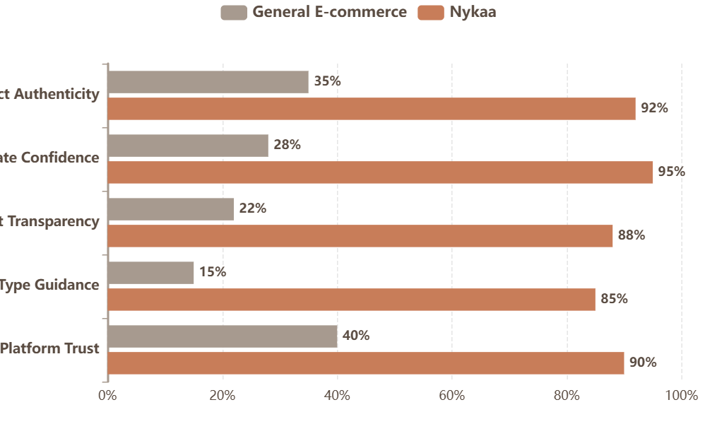
Consumer Psychology
Trust Levels: General E-commerce vs. Nykaa
Consumer Trust Comparison
Trust Gap Analysis
Why 60% of Indian beauty buyers avoided horizontal marketplaces
Authenticity Gap
57 pts
Expiry Confidence
67 pts
Transparency
66 pts
Skin Guidance
70 pts
Overall Trust
50 pts
Platform Performance
General E-commerce: Optimized for infinite variety, structurally unable to curate sellers effectively
Nykaa: Deep category expertise, guaranteed authenticity, personalized guidance

Slide 8
Consumer Psychology
The Guidance Imperative: Education as Risk Mitigation
The Paradox of Choice
What Consumers Needed vs. What They Received
The Indian beauty consumer faced a paradox of choice. They encountered hundreds of products with complex active ingredients like retinols, acids, and serums. The cognitive load associated with purchasing decisions increased exponentially as buyers transitioned from basic hygiene to complex multi-step regimens.
What They Needed
• Skin type assessment and compatibility guidance
• Ingredient education and active component analysis
• Climate and pollution-adjusted recommendations
• Step-by-step regimen building support
Hyper-Specific Guidance Needs
What They Received
Indian buyers needed education on product suitability based on hyper-specific variables: individual skin type, localized climate conditions, pollution exposure, and specific dermatological concerns. Before a monetary transaction could occur, the consumer required profound epistemic validation.
• Product listings with basic descriptions
• Algorithmic recommendations based on browsing
• Price comparisons and discount notifications
• Generic reviews without context
Nykaa's Insight
Platform Failure: Horizontal platforms optimized for transaction volume could not provide the mentorship relationship that builds loyalty. They pushed algorithms designed to maximize immediate basket size.
Education acted as a psychological anchor. It reduced purchase anxiety, clarified premium product value, and transformed hesitant buyers into informed consumers.

Slide 9

Chapter Three
Business Model
Analysis
Inventory Model vs. Marketplace Model

Slide 10
Business Model Analysis
How Inventory Control Enabled Authenticity Guarantees
Direct Sourcing from Manufacturers
Inventory Model vs. Marketplace Model
Nykaa adopted a pure inventory model. They sourced products directly from manufacturers and authorized distributors. They legally owned every unit before it reached the consumer. This approach eliminated supply chain pollution entirely.
Marketplace Model
• Platform acts as intermediary
• Third-party sellers own inventory
• No quality control guarantee
Strict FIFO Warehouse Protocols
• Fractional commission revenue
By legally owning the inventory, Nykaa achieved absolute control over quality assurance. Counterfeit duplicates were systematically eradicated, and strict first-in, first-out warehouse management protocols ensured expiry date issues were entirely resolved.
Nykaa's Inventory Model
• Platform is direct retailer
• Nykaa legally owned all inventory
• Absolute quality assurance
Three Critical Advantages
• Full retail margin capture
1
2
3
Customer Loyalty Followed Authenticity: When consumers knew every product was genuine and expiry dates were managed properly, they returned. Trust translated directly into repeat purchases.
Authenticity Guarantee
Expiry Control
Full Margin Capture
Counterfeit products could not enter the ecosystem
FIFO protocols eliminated date issues
Captured complete retail margin

Slide 11
Business Model Analysis
Unit Economics: Margin Capture and Private Label Strategy
The Margin Capture Advantage
Marketplace Model Economics
Transaction Value
₹450
₹200
₹450
Wholesale
₹250
Retail
Commission Rate
5-15%
Margin
₹23-68
Nykaa's Cost
Consumer Price
Platform Revenue
125% Margin: By purchasing 10,000 units directly from manufacturers, Nykaa secured deep wholesale discounts and captured the complete 250 rupee margin.
Limited Revenue: Marketplace models settled for fractional commission fees, leaving massive margin potential untapped.
How Nykaa Funded Growth
Nykaa's Inventory Model Economics
This margin capture was the financial engine that funded intensive customer education and content creation efforts required to maintain market dominance.
Retail Price
₹450
Wholesale Cost
₹200
Educational Content
Community Platform
Gross Margin
₹250
Margin Multiple
4-11x
Compared to marketplace commission

Slide 12
Business Model Analysis
Regulatory Arbitrage: Navigating Indian FDI Laws
Indian FDI Regulations
A Legally Protected Moat
The Indian state imposed highly stringent, protectionist regulations regarding Foreign Direct Investment in retail commerce. These policies historically protected domestic mom-and-pop stores from multinational retail conglomerates.
This asymmetric regulatory environment provided Nykaa with a massive, legally protected, and highly defensible competitive advantage.
Amazon & Flipkart
Structurally forced to remain open marketplaces with inherent quality control vulnerabilities
Foreign Giants Were Structurally Restricted
100% FDI was permissible solely within the 'Marketplace Model'. Foreign-owned entities like Amazon India and Walmart-backed Flipkart were legally prohibited from operating a pure inventory model at scale.
Nykaa
Leveraged legal right to operate closed, curated inventory model, systematically monopolizing trust
The Asymmetric Environment
Strategic Advantage: Foreign giants could not replicate the trust Nykaa built because they were legally barred from the inventory model that guaranteed authenticity.
Foreign Players
Nykaa (Domestic)
• Forced to remain marketplaces
• Could operate inventory model
• Could not own inventory
• Legal right to own stock
• Quality control vulnerabilities
• Absolute quality assurance
• Insurmountable trust deficits
• Monopolized consumer trust

Slide 13

Chapter Four
Content-to-Commerce
Strategy
Education Over Sales: Nykaa's Marketing Engine

Slide 14
Content-to-Commerce Strategy
The Three Pillars: Magazine, Network, and Influencers
Nykaa Beauty Book
Nykaa Network
Influencer Ecosystem
Launched an in-house digital magazine with deep instructional content: regimen building guides, ingredient analysis, and objective advice for specific dermatological concerns.
Built a proprietary digital ecosystem facilitating peer-to-peer Q&A, unfiltered reviews, and validation of product efficacy without corporate interference. Reached 1 million members by 2019.
Developed a structured network of 50+ influencers blending macro-celebrities (Katrina Kaif) for mass awareness with 25-30 specialized makeup artists for authentic, instructional content.
Positioned Nykaa as: Authoritative beauty educator
Created: Social proof at scale with network effects
Delivered: Both reach and authentic expertise
The Three-Pillar Content Strategy
Education Reduced Anxiety
1
Editorial Authority
Education acted as a psychological anchor in digital retail. It systematically reduced purchase anxiety, clarified the value proposition of premium products, and transformed uncertain first-time buyers into informed consumers.
Cultivated epistemic trust through rigorous, unbiased educational content
2
Peer Validation
Leveraged psychological power of social proof in beauty decisions
Mentor-Student Relationship
3
Demonstrative Content
When Nykaa invested in educating users rather than pushing algorithms for basket size, it shifted the relationship paradigm from vendor-purchaser to mentor-student, creating resilience to competitor discounting.
Visual tutorials proving efficacy through application techniques

Slide 15
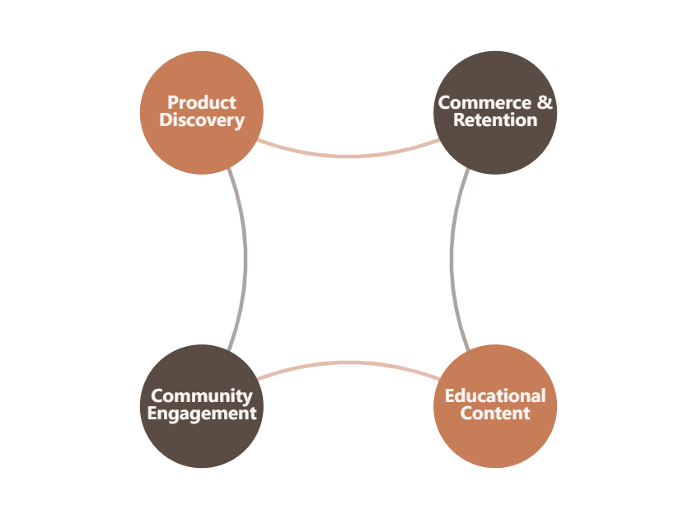
Content-to-Commerce Strategy
The Flywheel Effect: Content Driving Commerce
The Flywheel: Content → Community → Commerce
Educational Content
Free Education Attracted Users
Deep instructional guides, ingredient analysis, and regimen tutorials drew users organically to the platform. 5 million active users driven by content, not ads.
Community Engagement
Community Built Trust & Social Proof
Peer-to-peer Q&A and user reviews created powerful network effects. 15-20% of users engaged in non-transactional community features regularly.
Product Discovery
Trust Led to Organic Discovery
Educated consumers discovered products through routine-based recommendations, not paid advertisements. Trust eliminated purchase friction.
Commerce & Retention
Loyalty Fueled More Content Investment
70% repeat order rate generated predictable revenue that funded continued content and community investment, completing the flywheel.

Slide 16
Content-to-Commerce Strategy
Omnichannel Strategy: Physical Stores as Trust Anchors
70+ Stores Across 38 Cities
Stores as Psychological Mechanisms
Nykaa aggressively expanded its physical retail footprint, establishing over 70 premium retail stores deeply integrated across 38 distinct tier-1 and tier-2 Indian cities by 2021.
This physical presence was not intended merely as a secondary, offline sales channel. Rather, it functioned as a highly sophisticated psychological mechanism designed to build tangible, unshakeable brand trust.
Validation of Authenticity
Physical presence proved the platform was legitimate and permanent
Offline-to-Online Conversion
Traditional consumers could verify quality before buying online
The "Touch and Feel" Experience
Omnichannel Synergy
In a high-risk consumer category like personal care and cosmetics, the ability to physically interact with products, to swatch colors, smell fragrances, and test textures, was crucial for converting skeptical, traditional offline demographics into digital consumers.
Physical touchpoints drove subsequent online retention
Store Performance Metrics
70+
38
Physical Stores
Cities Covered
Strategic Insight: Physical stores acted as experiential brand embassies, providing a halo of legitimacy and permanence that validated the online platform's authenticity.
Stores served as critical offline touchpoints that drove online retention, creating a perfect loop of omnichannel synergy.

Slide 17

Chapter Five
Financial
Performance
Retention Metrics & Unit Economics Analysis

Slide 18
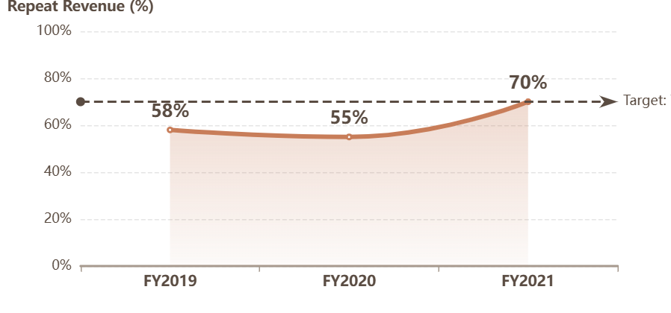
Financial Performance
The Retention Surge: From 55% to 70% Repeat Revenue
Nykaa's Retention Trajectory (FY2019-2021)
Retention Metrics by Year
FY19
Repeat Revenue
58%
Already healthy reliance on returning customers
FY20
Repeat Revenue
55%
Temporary dip during aggressive new user acquisition
FY21
Repeat Revenue
70%
Massive surge indicating ecosystem lock-in
Industry-Defining Surge: The 70% repeat order rate reached in FY2021 represented absolute market capture and deep ecosystem lock-in, guaranteeing predictable recurring revenue.
Key Insight: The 70% repeat order rate essentially guaranteed highly predictable, highly profitable recurring revenue, thoroughly insulating Nykaa from rising digital acquisition costs.
The Community-Retention Correlation
The data revealed a clear correlation: Nykaa's network reached 1 million members by 2019. Two years later, repeat revenue hit 70%. This lagging indicator validated the content investment strategy.

Slide 19
Financial Performance
CAC Reduction Through Organic Content Acquisition
Traditional E-commerce: The Paid Marketing Trap
The LTV Equation: How Retention Impacted Every Variable
Traditional horizontal e-commerce relied on expensive performance marketing through Google pay-per-click and Facebook paid campaigns to acquire every single customer.
Customer Lifetime Value =
Result: Structurally high, constantly inflating Customer Acquisition Cost (CAC)
(Avg Order Value × Purchase Frequency) ÷ Churn Rate
Average Order Value ↑
Education promoted multi-product regimens
Purchase Frequency ↑
Daily engagement through content
Churn Rate ↓
Nykaa's Model: Organic Content-Driven Acquisition
Authenticity eliminated counterfeits
By building an organic, highly engaging content ecosystem, Nykaa generated massive volumes of inbound, organic traffic. Consumers were drawn to the platform for free education.
The Compounding Effect
Result: Drastically lowered aggregate CAC through continuous non-transactional engagement
70%
~0%
Repeat Order Rate
Churn for Satisfied Users
The soaring 70% repeat order rate mathematically dictated massive, compounding expansion in Customer Lifetime Value.

Slide 20

Strategic Conclusions
Vertical Integration Won Because Trust Supersedes Convenience
In retail categories characterized by high perceived physical risk, consumer trust absolutely supersedes platform convenience. Horizontal marketplaces, fundamentally restricted by their sheer scale, could not effectively moderate quality control at the granular level required for cosmetics.
Nykaa's inventory-first model, regulatory navigation, and content-to-commerce engine created an insurmountable moat. The 70% repeat order rate and 62 crore rupees profit in FY2021 proved that vertical integration was not merely a marketing strategy, but a mathematically superior financial mechanism.
The lesson for emerging markets: Content is the new fulfillment. Modern digital retail must evolve beyond transactional interfaces to build engaged, educated communities rather than merely acquiring lists of buyers.
Research Complete
$2.7B
70%
62Cr
Market Captured
Repeat Revenue
FY2021 Profit

